Slide 1
CET 105 – Computational Thinking
The Steady Decrease of Voter turnout in Greek Legislative Elections
By Fotios Kyritsakis

Slide 2
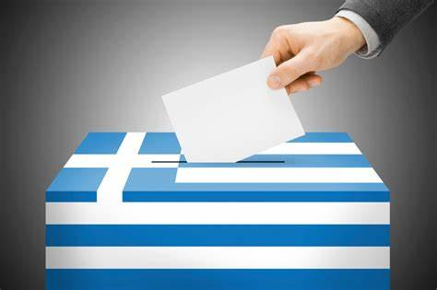
The Problem
Voter Turnout is at an all time low in 2022
Less people show up to cast their vote
High frequency of invalid votes, as a form of a silent protest

Slide 3


Some History…
1989: The All-time high
Switching from Left to Right wing Governments and governing style
Falsifying Economic Stats to get into the EU
Hosting the 2004 Olympics
Growing Tax Rates
Economic Policies changes with each Government

Slide 4
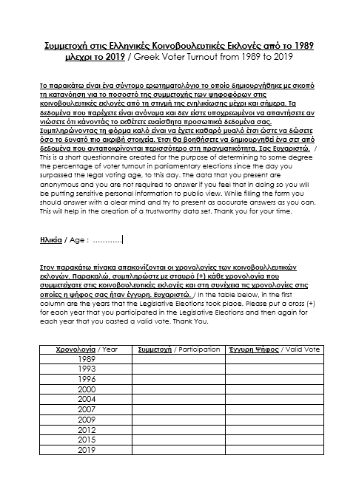
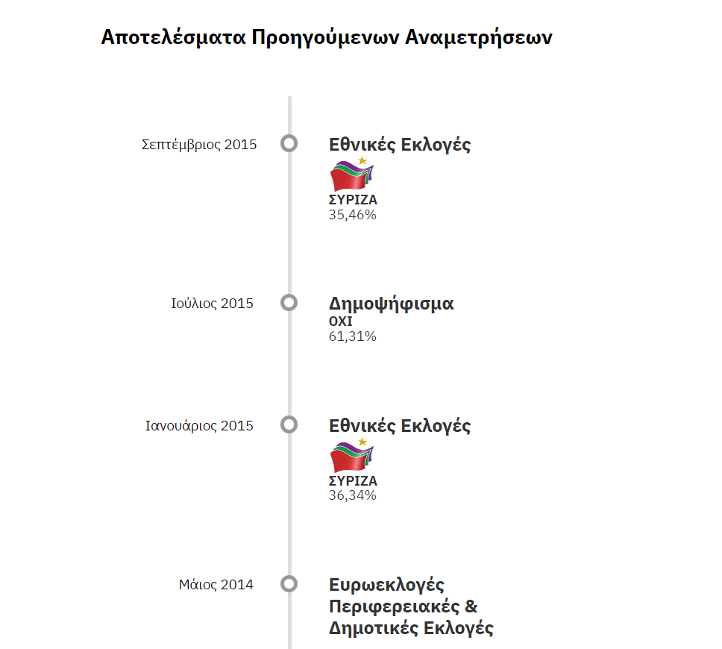
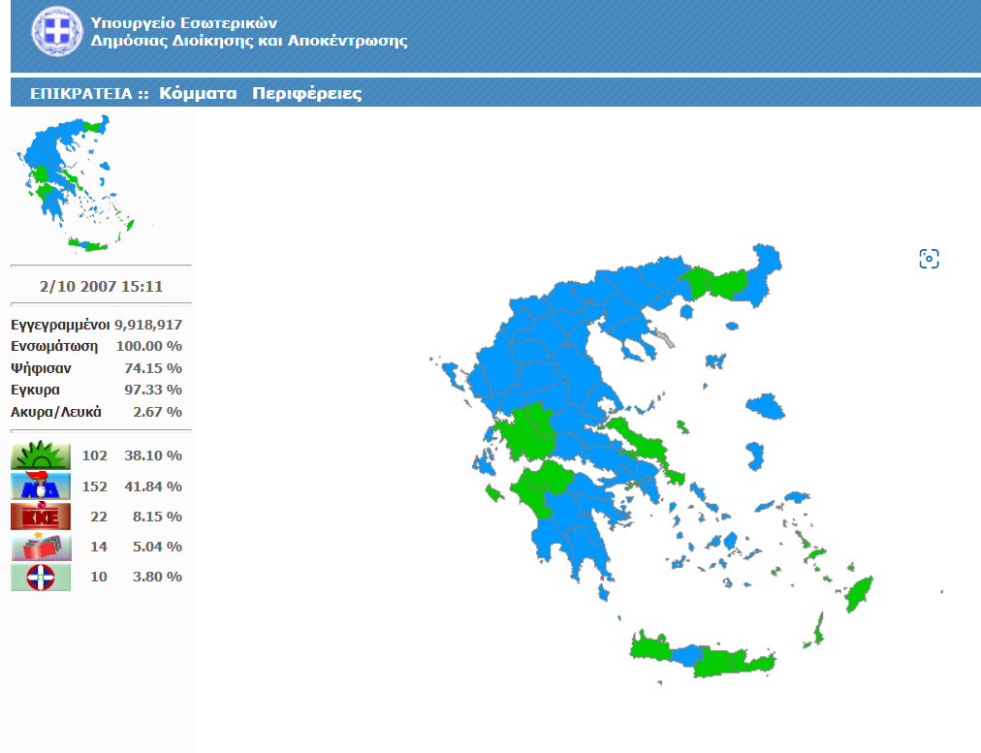
Gathering Viable Data
Public Databases and numbers of votes cast in past Elections change each year
Mix of Statistic Companies and Internet Archive to find a median
Physical Questionnaires :
Age
List of Election dates with two checkboxes ( Participation, Valid Vote Cast)
ekloges.ypes.gr
ekloges-prev.singularlogic.eu

Slide 5

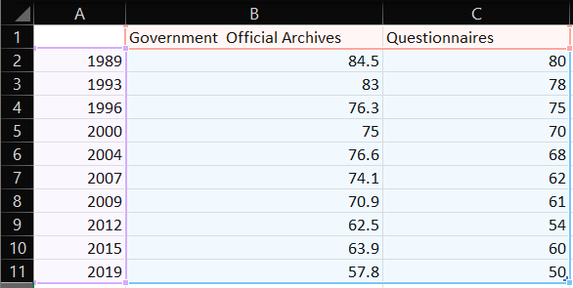
Results
Researched Data
Questionnaires

Slide 6

Conclusions
Greeks feel less and less represented in the Parliament
Greeks find the new electronic system too Complicated
Lack of basic technological understanding for a great percentage of the Greek population
Lack of clear policy distinctions between the Political Parties
Not enough information and deliberate spread of misinformation by Medea
Most Greeks do not feel that their vote will actually change anything

Slide 7

What I learnt during my research
Data validation from questionnaires
Use of online polling methods is mandatory to acquire a greater number of accurate data
The Greek Online Voting system needs an update
More technological education for the public

Slide 8

Thank for listening

